Slide 1
Brake Failure Detection Indicator Device with IC 555 Timer
Course Teacher: Dr. Muhammad Morshed Alam
Department of Electrical and Electronic Engineering
SL # | Students ID | Students Name | Program
1 | 22-46207-1 | Rafsan Mahmud | BSc in CSE
2 | 22-46211-1 | Akid Mahmud | BSc in CSE
3 | 22-46229-1 | Ishtiak Billah Emon | BSc in CSE
4 | 22-46242-1 | M Shahriar Alam Shajid | BSc in CSE
5 | 21-45751-3 | Ekramul Hossen Himel | BSc in CSE

Slide 2


Outline of the Presentation
Objectives
Introduction
Research/Working Method
Description of the Work
Results and Discussions
Conclusions
Future Works

Slide 3
Objective
Objectives of the Work
Develop a cost-effective and reliable Brake Failure Detection System using an IC 555 timer integrated circuit.
Implement a circuit using IC 555 to monitor brake fluid pressure and activate the indicator in the event of a brake failure or low brake fluid levels.
Optimize power consumption to enhance the device's efficiency and prolong battery life, ensuring practicality and sustainability.
Aim to contribute to improved road safety by preventing accidents related to brake failures through the successful implementation of the IC 555-based Brake Failure Detection System.
Providing tips and recommendations on how to optimize the circuit's performance and ensure its longevity in real life use.

Slide 4
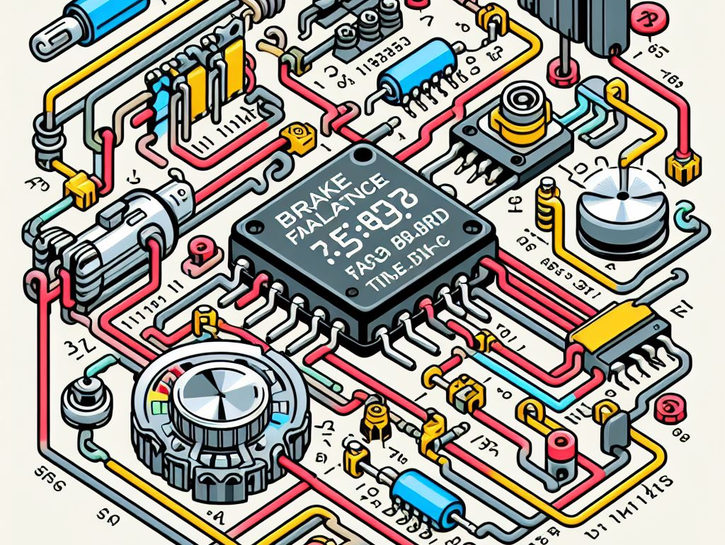
Introduction
We are going to show you how to make a Break Failure Indicator Circuit using 555 Timer IC. This circuit can be attached to a vehicle, and it will monitor the brakes of the vehicle. In case of any brake failure, it will provide us with audio-visual feedback.

Slide 5
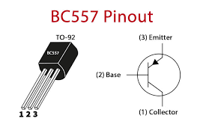
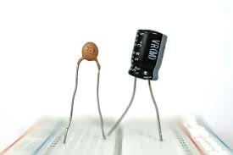
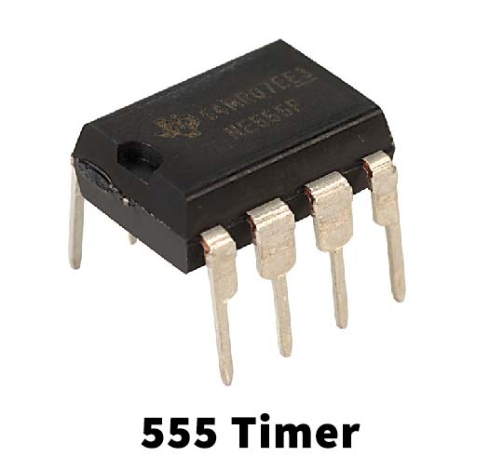
Equipment's
SL NO. | Components | Models | Quantity
1 | Transistor | Bc557 | 1
2 | IC | 555Timer | 1
3 | Battery 9V |  | 1
4 | Active Buzzer |  | 1
5 | Resistor | 1k ohm,440k ohm | 2
6 | Breadboard | 400 Point | 1
7 | Voltage Regulator IC | 7805 | 1
8 | Some weirs |  | 1
9 | Capacitor | 0.1uF,1uF | 2

Slide 6
Description/Methodology of the Work
BC-557 Transistor:
The BC557 is a PNP bipolar junction transistor (BJT) used for amplification and switching applications.
The BC557 has three terminals: emitter (E), base (B), and collector (C), arranged in a sandwich-like structure of semiconductor material.
In its quiescent or normal state, the BC557 is biased by applying a positive voltage (VCC) to the collector, connecting the emitter to ground, and using the base as the control terminal.
The forward biasing causes the transistor to amplify the small input current at the base, resulting in a larger current flow from the collector to the emitter. This amplification is a key characteristic of transistors.
The current flowing through the base-emitter junction controls the larger current flowing from the collector to the emitter. The collector current is directly proportional to the base current.
The BC557 can function as a switch. Applying a small signal at the base either allows or inhibits the flow of a larger current between the collector and emitter. When the base signal is present, the transistor is "on" or conducting; when absent, it is "off" or non-conducting.
To turn off the BC557, the base-emitter junction needs to be reverse-biased or the base connection needs to be removed. This interrupts the flow of current from the collector to the emitter, effectively turning off the transistor.

Slide 7
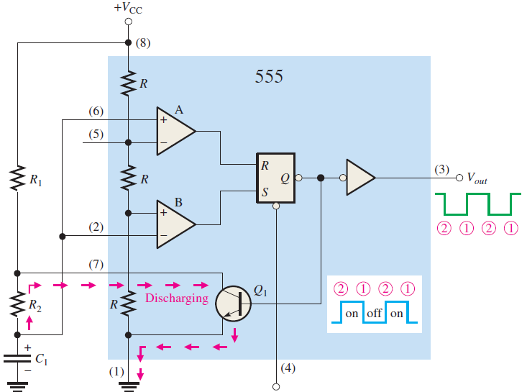
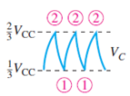
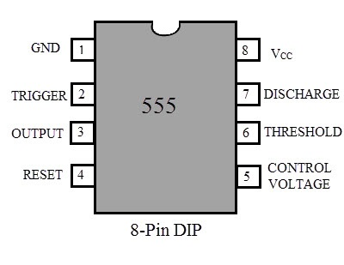
Description/Methodology of the Work
555 Time Working Method:
Understand that the 555 timer IC has three operational modes: Astable, Monostable, and Bistable.
Pin Configuration:
Familiarize yourself with the pin configuration of the 555 timer. The important pins include GND (Ground), TRIG (Trigger), OUT (Output), DISCH (Discharge), VCC (Supply Voltage), and CV (Control Voltage).
Basic Astable Mode Operation:
In Astable mode, the 555 timer can produce a continuous square wave output. Connect pins 2 (TRIG), 6 (THRS), and 7 (DISCH) as per the Astable configuration.
Timing Components:
Use external resistors (R1 and R2) and a capacitor (C) to set the frequency and duty cycle of the output waveform. Adjust their values to achieve the desired timing.
Output Signal:
The OUT pin (pin 3) of the 555 timer produces a square wave. This signal can be used to control external components, such as transistors.
Transistor Connection:
Integrate a transistor (NPN or PNP) into the circuit based on your requirements. For example, to drive a load, connect the collector of an NPN transistor to the load, the emitter to the ground, and the base to the OUT pin of the 555 timer through a current-limiting resistor.
Load Control:
When the 555 timer output goes high, it turns on the transistor, allowing current to flow through the load. When the output goes low, the transistor turns off, cutting off the current to the load.

Slide 8
Description/Methodology of the Work
In this project, the 555 timer operates in astable mode, generating a continuous square wave with adjustable On/Off times. The timer's operation plays a crucial role in controlling the behavior of the circuit, which includes a PNP-type transistor (BC557), Red LED, Green LED, and a buzzer. Here's a step-by-step explanation of how the 555 timer works in this project:
Astable Configuration:
The 555 timer is set up in astable mode by connecting resistors R1 and R2, and capacitor C1. This configuration allows the 555 timer to oscillate and produce a continuous square wave output.
Timing Components:
The values of resistors R1 and R2, along with capacitor C1, determine the timing characteristics of the astable multivibrator. Adjusting these values allows for control over the On and Off times of the output pulse.
Output Pulse:
The output pulse from the 555 timer is used to control the PNP-type transistor (BC557) and, indirectly, the LEDs and buzzer.
Transistor Control:
The base of the BC557 transistor is connected to VCC when the brake wire is intact. In this condition, the base-emitter junction is forward-biased, allowing current to flow from the collector to the emitter.
GREEN LED Activation:
The current flowing through the Base-Emitter path of the transistor activates the Green LED. As long as the brake wire is intact, the Green LED remains on.
Buzzer and Red LED Deactivation:
In the normal state, with the brake wire intact, the BC557 transistor keeps the buzzer and Red LED disconnected from the ground, ensuring they remain off.
Brake Wire Cut:
When the brake wire is cut, the base connection of the BC557 transistor is disrupted. This disconnects the transistor, interrupting the flow of current through the collector-emitter path.
Green LED Deactivation:
With the base connection severed, the current through the collector-emitter path ceases, turning off the Green LED.
Buzzer and Red LED Activation:
Now that the BC557 transistor is disconnected, the buzzer and Red LED are connected to the ground. This enables them to turn on and start beeping and blinking based on the astable operation of the 555 timer circuit.
In summary, the 555 timer in astable mode serves as the timing source for the project, controlling the On/Off times of the output pulse. The PNP transistor and associated components, including the LEDs and buzzer, respond to the 555 timer's output, providing a dynamic indication of the brake wire status in the circuit.

Slide 9
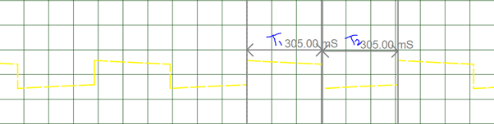
Experimental Data Analysis
& Calculation
In our case the value for R1 = 1000ohm and R2=440000ohm and C1=0.000001F. So using these formulae we can calculate our values to be
T1 = 0.693(R1+R2).C1
T2 = 0.693*R2*C1
T = T1+T2
F = 1/T
Duty Cycle = T1/(T1+T2)
555 Timers in Astable Mode:
The Astable mode in a 555 timer is mainly used for Blinking LEDs or to do some periodic Turn On and Turn off actions. In this project we have configures the Timer to work with 0.3Sec on time and 0.3sec Off time. The value of the resistors R1, R2 and capacitor C1 decides the on and off time of the Pulse produced. The formulas for calculating the same is given below.
The BS557 PNP transistor controls the LEDs and buzzer. When the Brake wire is in proper condition the base of this transistor is provided with 5V through a current limiting (R4) Resistor. This also drives the Green LED light and disconnects the Buzzer and Red LED from ground thus keeping it turned off.
When the break wire is cut the base of the BC557 is also cut and thus the Green LED is turned off and the Buzzer and Red LED are connected to ground. Since the positive end of Buzzer and LED is connected to the 3rd pin of 555 timers which is wired in Astable mode operation, they blink/beep based on the duration set by the above calculation.
So the output of the pulse should remain turned on for 0.305Sec and turned off for 0.304 seconds which is almost the same when analyzed on the graph below which was obtained with help of a Digital Storage oscilloscope.

Slide 10
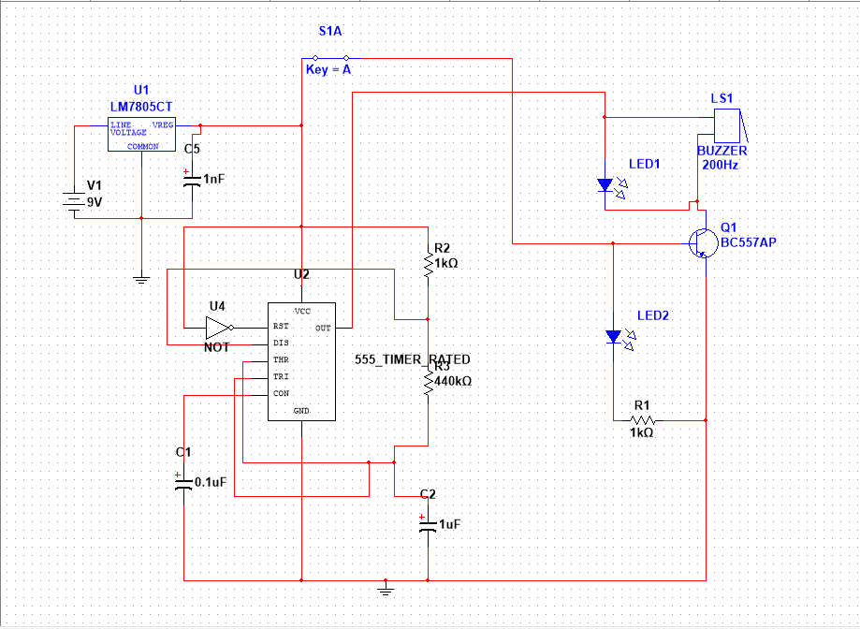
Description/Methodology of the Work
In this presentation, we showcase a meticulously designed circuit featuring the 555 timer operating in astable mode, serving as a versatile brake status indicator. The circuit's functionality revolves around the adjustable On/Off time of the 555 timer's pulse, achieved by manipulating resistors (R1 & R2) and capacitor C1. The incorporation of a PNP-type transistor (BC557) adds a layer of control based on the brake wire status. When the brake wire is intact, the transistor's base is connected to VCC, activating only the Red LED. However, cutting the brake wire disconnects the transistor, turning off the Red LED and activating the buzzer and Green LED, connected to the ground. This dynamic setup allows for effective brake status indication through beeping and blinking, the timing of which can be fine-tuned by adjusting the circuit's components. The circuit's practical applications extend to automotive systems, providing a reliable means of alerting users to brake wire issues. Overall, the astable mode 555 timer circuit offers simplicity, adjustability, and real-world utility in brake status monitoring.
Figure: Circuit Diagram

Slide 11
BC-557 Transistor Application in Project
Normal Operation (Brake Wire Intact)
In the normal condition, when the brake wire is intact, the base of the BC557 transistor is connected to VCC. This forward-biases the base-emitter junction, allowing current to flow from the emitter to the base.
Transistor Biasing:
The forward biasing of the BC557 transistor allows a current to pass from the collector to the emitter. This current is controlled by the current flowing through the base-emitter junction.
Red LED Activation:
The current flowing through the collector-emitter path activates the Red LED, as it is connected in such a way that it lights up when current flows through it.
Buzzer and Green LED Deactivation:
In this state, the buzzer and Green LED are effectively disconnected from the ground, ensuring they remain off despite the astable operation of the 555 timer circuit.
Brake Wire Cut:
When the brake wire is cut, the base connection of the BC557 transistor is disrupted. This effectively disconnects the transistor, interrupting the flow of current through the collector-emitter path.
Red LED Deactivation:
With the base connection severed, the current through the collector-emitter path ceases, turning off the Red LED.
Buzzer and Green LED Activation:
Now that the BC557 transistor is disconnected, the buzzer and Green LED are connected to the ground. This enables them to turn on and start beeping and blinking based on the astable operation of the 555 timer circuit.
In this project, the BC557 PNP transistor plays a crucial role in controlling the activation of the buzzer, Red LED, and Green LED based on the status of the brake wire.

Slide 12
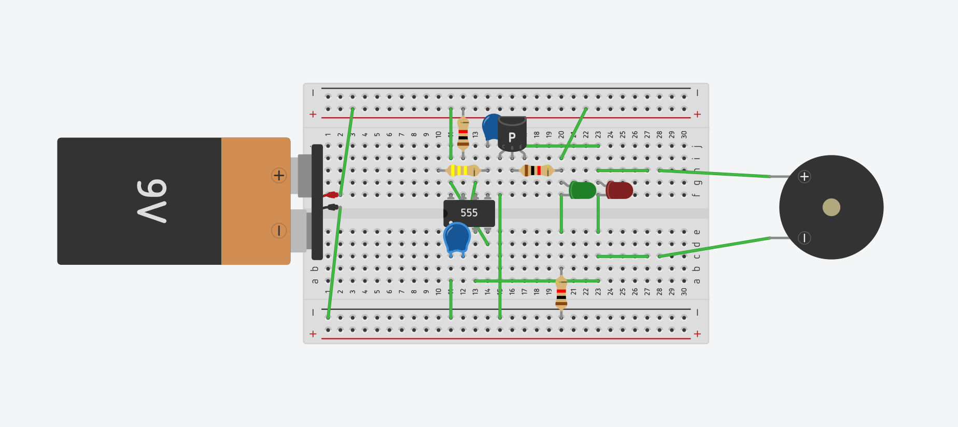
Description/Methodology of the Work
Connections:
Connect Pin 4 and Pin 8 To VCC.
Use a jumper wire to connect Pin 6 and Pin 2 together.
Use a jumper wire to connect Pin 1 to GND.
Connect the 1uF capacitor between Pin 2 and GND.
Connect the 0.1uF capacitor between Pin 5 and GND.
Add Red LED & Buzzer in parallel between Pin 3 and Collector of Transistor.
Connect the R1 Resistor between Pin 7 and VCC.
Connect the R2 Resistor between Pin 6 and Pin 7.
Add Green LED to the Base of the transistor with a resistor.
Connect the Emitter of the Transistor to the GND.
Insert the Brake wire between the Base of the transistor and the VCC.
Figure: Project Diagram

Slide 13
Conclusions
In conclusion,
while the 555 timer circuit demonstrated its effectiveness in the brake failure indicator project, its versatility extends to a myriad of other applications across various industries and educational domains, showcasing its significance as a fundamental and adaptable component in electronics.
The 555 timer, owing to its versatility and reliability in generating precise timing pulses, holds potential for various applications beyond brake failure indicators, including:
Timing and Oscillation in Electronics: The 555 timer can be utilized in numerous electronic circuits requiring precise timing, such as oscillators, timers, and pulse generators across various industries.
PWM (Pulse Width Modulation): Its ability to generate square waves at adjustable frequencies makes it suitable for applications like motor speed control, light dimming, and power regulation.
Sensor Signal Conditioning: Incorporating the 555 timer to condition signals from sensors for data acquisition, signal processing, and control systems in automation and robotics.
Educational Purposes: Due to its simplicity and widespread use, the 555 timer serves as an excellent educational tool for teaching basic concepts of timing circuits, electronics, and signal generation.
Home Automation: Utilizing the 555 timer in home automation projects for timing-based tasks like turning lights on/off, controlling appliances, or creating simple alarm systems.

Slide 14

Thanks for listening our presentation….

